Slide 1
Why have economic reforms in Mexico not generated growth?
Author: Timothy J. Kehoe and Kim J. Ruhl
Presenter: Shulin Miao

Slide 2
Background
During the decade that followed 1985, Mexican government implemented a series of market-oriented reforms:
fiscal reforms, privatization of government operated firms, and opening the economy to trade and foreign investment.
E.g. implementation of North American Free Trade Agreement (NAFTA) in 1994.

Slide 3
Around the same time, China, another large, less developed country, implemented similar market oriented reforms, started opening itself to the rest of the world.
E.g. joined the World Trade Organization (WTO) in 2001.
However, Mexico's economic growth since 1985 has been modest, at best, compared to China’s rapid growth.

Slide 4
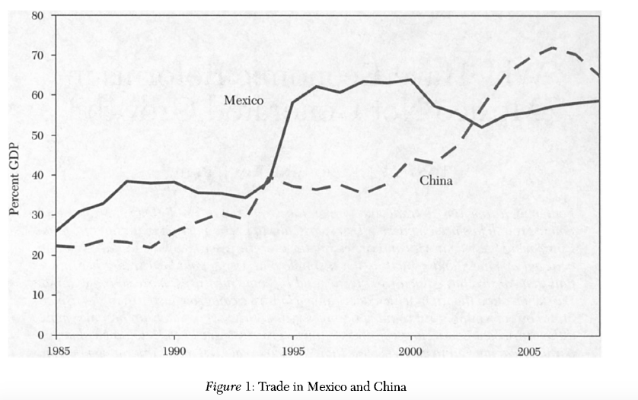
Figure 1 presents data on Mexico's trade in goods and services as a percentage of its GDP

Slide 5
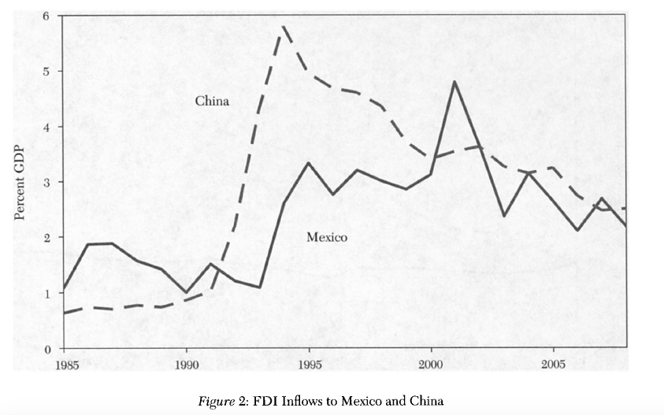
figure 2 presents data on inflows of foreign direct investment (FDI)

Slide 6
The question of this paper is: why Mexico stagnated after opening itself to trade and foreign investment while China grew rapidly.

Slide 7
Logic of the study
1. Figure out the factors impeding growth in Mexico. For each of these factors, they ask: Does China share this characteristic? And, if so, why has it not impeded growth in China?
2. Identify factors as the driving force behind Chinese economic growth, and ask: Why have these factors not been at work in Mexico?

Slide 8
Cautions for Gross-country growth regressions
First, the trade share is not a direct measure of openness policy and the relationship between measures of policies related to openness and growth does not seem to be robust, which is problematical.
Second, the empirical results of whether well specified growth regressions need to control for an appropriate measure of country size when studying the impact of openness are mixed.

Slide 9
Cautions for Gross-country growth regressions
Notable difference between Mexico and China
China has socialist economy
China has progressively liberalized since 1978, its trading system was still rife with quantitative restrictions at least as of 1994.
Mexico has lower than average tariffs on capital and intermediate goods and China has higher than average tariffs.

Slide 10
Gains from Trade and Real GDP
The empirical evidence on the link between trade and growth is inconclusive.
However, all of the models predict that trade reform increases welfare.
Therefore they use the real gross domestic income (GDI) of a country, as alternatives to real GDP, to capture the impact of changes in the terms of trade on welfare and productivity.

Slide 11
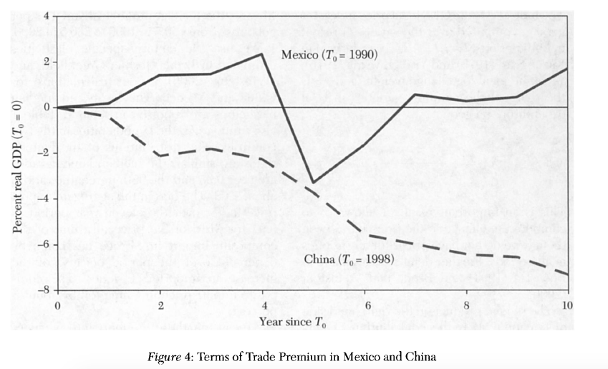
The percentage deviation of real GDI from real GDP for Mexico and China

Slide 12
Gains from the Terms of trade
Chinese real GDP overstates the growth in real gross domestic income by almost 8 percentage points over the decade considered. The intuition for this result is simple: The policies that keep the relative price of imports in China high make Chinese consumers worse

Slide 13
Gains from new varieties
The "trade models" based on differentiated varieties and increasing returns to scale imply that trade liberalization not only changes the prices of goods that were already available for consumption, but also changes the composition of varieties that are available for consumption.
In China, the median number of varieties per good was 300.5 in 1998 and grew to 406.0 in 2008. In Mexico, the median number of varieties per good rose from 150.5 in 1990 to 230.5 in 2000.

Slide 14
Price the composite import good—aggregate import bias
Over the eleven-year period, the price of a unit of the composite import in Mexico has fallen by 6 percent over the period because of the increase in imported varieties. The composite import price in China fell by about 5 percent.

Slide 15
Gains from trade and real gdp
Accounting for both the gain in varieties and the adjustment for the terms of trade, the growth rate of real income per capita in China is the 8.33 percent compared with 8.99 percent growth in real GDP. In Mexico, the gains from trade imply that real income has grown about 0.30 percent per year faster than real GDP.
Their measurements suggest that Mexico, despite slow growth in GDP, has reaped substantial benefits from the liberalization.

Slide 16
Studies of Mexico's Stagnation
Inefficient financial system, such as bankruptcy proceedings
Lack of contract enforcement
A rigid labor market

Slide 17
inefficient financial system
Inefficient financial system can misallocate labor and capital, leading to a low measure of TFP.

Slide 18
Lack of contract enforcement
After the Mexico financial crisis of 1994-95, while the traded goods sector grew rapidly, the nontraded sector recovered sluggishly. researchers argue that this occurred because domestic bank lending dried up after the crisis, and traded goods firms were able to obtain financing from abroad while nontraded goods firms were not.
One of the reasons that lending dried up was that poor contract enforcement such as the inefficient bankruptcy procedures generated a large quantity of nonperforming loans.
Other researchers develop a model in which rapid GDP growth cannot be sustained over a long period if it is driven only by growth in the traded goods sector, because firms producing traded goods need nontraded inputs.

Slide 19
A rigid labor market
There is an institutional vacuum in the agricultural sector after government intervention there was reduced as leaving many producers with less access to credit and technical assistance.

Slide 20
However, China also has these same problems, but why these did not impede growth as they did in Mexico?
Because China is at a lower level of development.

Slide 22
To compare China with Mexico in terms of absolute level of income, they use the PPP(purchasing power parity) real GDP data published by the World Bank (2008). China has been growing more rapidly than Mexico but is still substantially poorer in 2008. Specifically, Chinas GDP per working-age person in 2008 is 7,986 2005 U.S. dollars, which is only 38.5 percent of Mexico's 20,755 dollars, and its GDP per capita in 2008 of 5,712 dollars is only 42.5 percent of Mexico s 13,434 dollars.

Slide 23
Studies of Chinas Fast Growth
The Neoclassical Growth Model
They choose the neoclassical growth model-- aggregate Cobb-Douglas production function to guide their view of economic data.
where Yt is output, At is TFP, Kt is capital, and Lt is labor input.

Slide 24
In their growth accounting, growth in human capital shows up as growth in TFP.
They also finds that capital is much less important and increases in productivity are typically the driving force of economic growth.

Slide 25
Growth Accounting for China

Slide 26
Growth Accounting for Mexico

Slide 27
The poor performance in terms of real GDP growth is driven by an even worse performance in terms of TFP growth.
On the contrary, Chinese total factor productivity(TFP) grows steadily.

Slide 28
Studies of Chinas Fast Growth
Half of Chinese TFP growth was due to productivity differences between entering and exiting firms during 1998-2005.
China’s 2001 accession protocol to the World Trade Organization forced the Chinese government to drastically cut subsidies to the state-owned sector and show that this generated a reallocation from inefficient state-owned firms to efficient private firms.

Slide 29
However, trade and foreign investment reforms resulted in large increases in productivity in the manufacturing sector in Mexico, especially in the machinery and equipment, computing equipment, and precision instruments industries.
This suggests that the problem in Mexico is lack of productivity growth, not in manufacturing but in the rest of the economy. It further suggests that we should look at lack of competition in other sectors in Mexico, such as petroleum extraction, electricity, telecommunications, and transportation for the factors inhibiting productivity growth.

Slide 30
Another guess for China’s growth
We could also hypothesize that China has been able to grow because it has a strong central government that has been able to overcome some of the problems associated with poorly functioning markets, while Mexico has not been able to do this.

Slide 31
It is worth pointing out two reasons for doubting it:
First, Mexico became a democracy only in the mid-1990s; previously it had a one-party system that was in many ways as strong and centralized as that in China. While the Mexican government controlled the banking system from 1982 through 1991, the inefficient allocation of credit during this period as a major factor in Mexico's poor economic performance.
Second, until China joined the WTO, the banking system there served mostly to funnel savings into investment in inefficient state-owned enterprises. Allocation of credit by the government seems to have been the major problem in the financial systems in both Mexico and in China, not a remedy for other problems.

Slide 32
a Proposed Theoretical framework
China is at a lower level of development, still at the catch-up period. Mexico already had this sort of catch-up during the period 1953-81.
China’s real GDP is overstated, but Mexico’s understated. Mexico has reaped substantial benefits from the liberalization.
The problem in Mexico is lack of productivity growth, not in manufacturing but in the rest of the economy. It further suggests that we should look at lack of competition in other sectors in Mexico, such as petroleum extraction, electricity, telecommunications, and transportation for the factors inhibiting productivity growth.

Slide 33
Directions for Future Research
It may be that the predominance of intrafirm trade between Mexico and the United States reduces the incentives toward competition and innovation that would arise from trade and foreign investment reforms.
Furthermore, Mexican manufacturing seems to be complementary with U.S. manufacturing. While Chinese manufacturing is a substitute for both Mexican and U.S. manufacturing.
The emergence of China may have reduced the incentives toward innovation in both the United States and Mexico.
Researchers suggests, that it is not the manufacturing sector, at least those subsectors most involved in trade, that is responsible for Mexico’s stagnation, but others.

Slide 34
Directions for Future Research
Unless China continues to reform, we can expect economic growth there to slow down sharply at some point. It is an open whether or not this slowdown will occur China is still behind Mexico in terms GDP per working-age

Slide 35
My opinion
Have an interesting research topic, and asked many inspiring questions
Provided and summarized many related study made by other researchers, a good reference book
However, there is no any data or numbers to concretely support their proposed framework
In general, it arises readers ‘ interest of the topic, and is a good foundation for future study, but as a study itself, its logic is not clear and conclusion is ambiguous. I believe it needs future detailed study.

