Slide 1
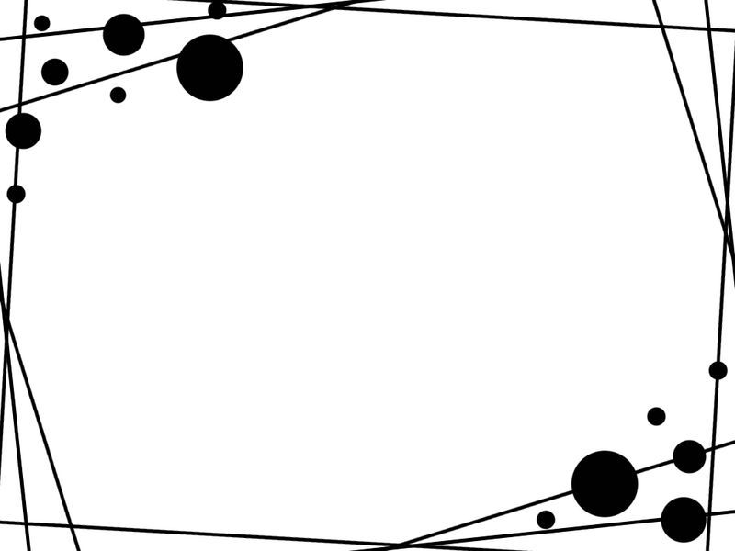
The Diversity Of high-frequency traders
By Björn Hagströme and Lars Nordén
Present By Alex Zheng

Slide 2
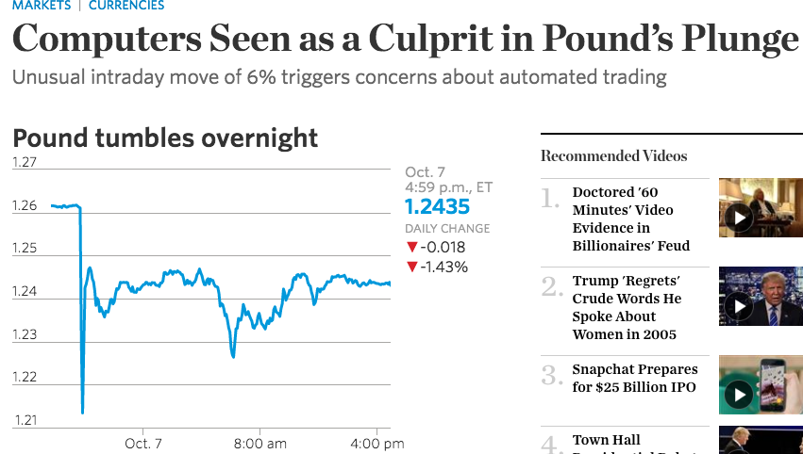
Recent on the new

Slide 3
Other relevant interesting topic
Michael Lewis – Flash Boys (2015)
Predators and Preys Relationship
Example
A Exchange has 100 shares of Apple
B Exchange has 100 shares of Apple [Signal takes longer to travel to B due to distance]
Brokerage firm C tries to buy 150 shares of Apple
HFT detects the order of 150 shares at A and race the brokerage to B, buy shares and resell to the brokerage. Liquidity you saw is not what you paid for.
Book Example:
Takes 2 milliseconds to travel to BATS and 4 milliseconds to travel to Carteret
A program that build delay into the signals to make two orders arrive at the same time
The order was fulfilled at the listed price
https://www.youtube.com/watch?v=wnPl0zvXkjM

Slide 4
Different HFTs
Market-making HFTs
A service provided to clients to minimize the price impact of trading
Opportunistic HFTs
A party uses technologically advanced trading algorithms to profit from the trading process itself
There were many research papers on the impact of HFTs on market quality but none of these paper has been able to distinguish different strategies in equity markets
This paper uses data from NASDAQ-OMX Stockholm and is able to subcategorize HFTs into market-making strategies and opportunistic strategies

Slide 5
Key contributions of this paper
Market makers vs Proprietary trading Identity
Influence of market-making HFTs on short-term volatility
Present empirical setting and data as well as its HFT categorization methodology
Event study: Causal effects of HFT activity on volatility

Slide 6
Data and sample collection
30 most traded stocks from OMX Stockholm 30
2 months of data (August 2011 – volatile, February 2012 – quiet)

Slide 7
Descriptive statistics in a glance

Slide 8
Characteristics of high-frequency traders
According to SEC, HFTs tend to
End the day with close to zero inventories
Frequently submit and cancel limit orders
Use co-location facilities and highly efficient algorithms, allowing them to minimize different types of latencies
Have short holding periods
→ Determine whether such conceptions of HFT behavior apply to our sample of HFT members

Slide 9
Low inventories
Due to overnight clearing and capital costs, market makers and opportunistic traders strive to have low overnight positions
Since the paper only studies one of the exchanges, it is possible for firms to have high inventories due to the fact that they are utilizing cross-market arbitrage

Slide 10
Frequent submissions and cancellation of limit orders
As the algos constantly scan the markets for news about fundamentals, order flows and relative prices, the optimal quotes are subject to continuous change
Order-to-trade ratio (q/t): the number of limit order submissions across members and stocks on a given trading day, divided by the number of executions across members and stocks on that day

Slide 11
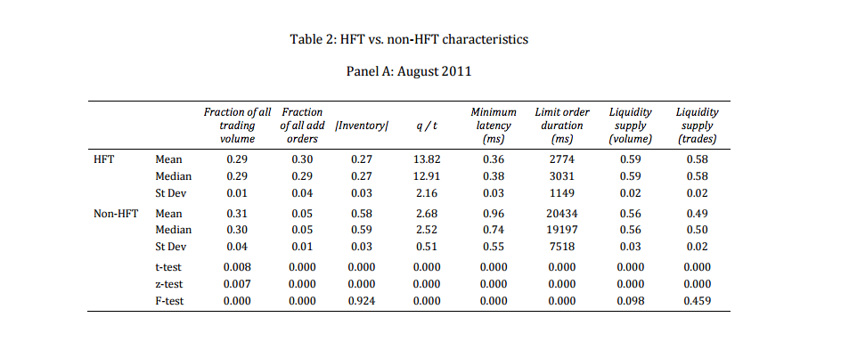
Characteristics Comparison

Slide 12
What we learned form the table?
HFTs are quoting more intensely than non-HFTs
Low inventory – expected as HFTs are well-known for minimizing their overnight exposure
Lower latency of HFTs

Slide 13
Within HFT Groups
Methodology of Separating within the HFT Groups
Randomize the order book snapshot time within each ten-second period to get observations that are uniformly distributed across the ten seconds
Market make presence = fraction of snapshots the member has a limit order posted at either side of the inside quotes

Slide 14
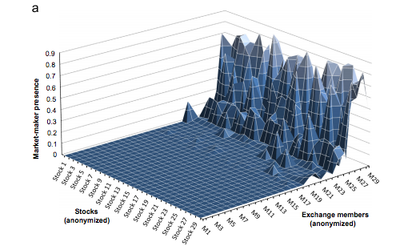
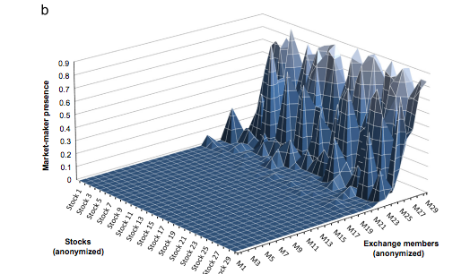
Activity within HFT Group

Slide 15
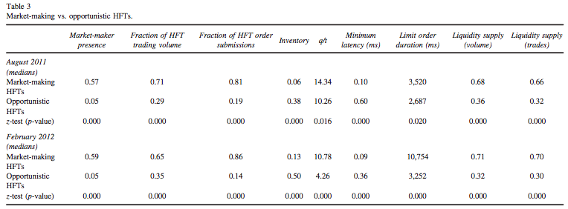
Market-making vs opportunistic HFTs

Slide 16
Characters of HFT market-maker
Make up the majority fraction of HFT trading volume
Lower inventory due to a smaller likelihood of arbitrage
High liquidity supply (almost double in each sample month)

Slide 17
Impact of volatility on HFT– an event study
An inherent problem when assessing the influence of HFT on volatility is the difficulty of determining the direction of causality
Possible that HFT affects volatility
Or, HFT tends to concentrate in the most liquid stocks in each market
Important Concept for later study
Tick Size: The minimum price change of a stock
For NOMX-St
Price <= SEK 50, tick size = SEK 0.01
SEK 50 < Price <= SEK 100, tick size = SEK 0.05
Price > SEK 100, tick size = SEK 0.1

Slide 18
Set-up
Event: We include an event if the last day before and the first day after the event day on which transaction prices remain in the same tick size category for the whole day
Control Group and Comparison Group Selection: Before January 2011 and after January 2011
42 events prior to January 2011 and 47 events after 2011
Low-tick and high-tick regimes
Difference-in-difference approach
Benchmark: Control the potential time-series variations in HFT activities in the event stock. Benchmarks are the rest of stocks on OMXS 30.

Slide 19
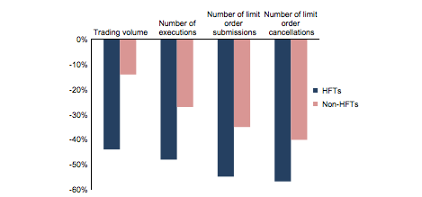
First, HFT vs Non-HFT’s response to tick size change

Slide 20
Trading volume market share following tick size changes

Slide 21
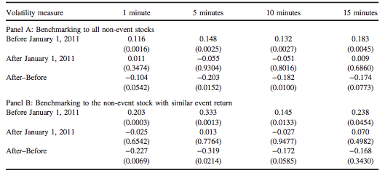
Intraday realized stock return volatility following tick size changes

Slide 22
Conclusion
Majority of HFT’s trading volume and more than 80% of HFT limit order submissions on NOMX-St are associated with market-making strategies
Market-makers have higher order-to-trade ratios and lower latency than opportunistic HFTs
Market-making HFT activities seem to be beneficial for the overall market quality in the sense that they reduce short-term volatility

Slide 23
My Opinion
Although some insights about HFTs, the paper provides relatively limited analysis on opportunistic HFTs
Still did not answer the predator-prey relationship brought up by Michael Lewis [Market maker HFT can use market order to buy and front run investors and use limit order to resell for a profit]
Minimum tick size as well as batch market mechanism can be considered in the near future for limiting quoting traffic without threatening the advantages of HFT activity

