Slide 1
On the Size of the Active Management Industry
PPT: Shuhan Li
Author: Lubos Pastor & Robert F. Stambaugh
Journal of Political Economy

Slide 2
Outline
Introduction
The Model
Prior and Posterior Beliefs
Is the Industry’s Size Puzzling Given its Track Record?
Future Size of the Active Management Industry
Relation to Berk and Green(2004)
Conclusion
Notes:
Section I is the introduction, and in Section II, they present their model. After describing the general setting, they first examine the case in which investors are risk neutral. The simple results obtained there for alphas, fees, and industry size clearly reveal the role of competition among managers and investors. They then move to a mean-variance setting, which forms the basis for their empirical work. Section III discusses the priors and their updating with data. Section IV presents the model’s quantitative implications for the industry’s current size given its historical track record. Section V calculates the expected future industry size after observing various potential future track records. It also discusses the properties of learning about returns to scale.

Slide 3
Modeling returns to scale
The active management industry faces decreasing returns to scale
Any fund manager’s ability to outperform a passive benchmark declines as the industry’s size increases
A simple way of modeling returns to scale
$α_{t}=a−b{\left(\frac{S}{W}\right)}_{t}$
Notes:
As more money chases opportunities to outperform, prices are affected and the opportunities become more elusive. A simple way of modeling returns to scale
is as follows
Alpha t is the industry’s expected return at time t in excess of passive benchmarks
(S/W) t is the industry’s size as a fraction of the total amount managed actively and passively.
Decreasing returns to scale are captured by b > 0.
If the benchmarks are sufficient for pricing assets in an efficient market, alpha t reflects asset mispricing
This modeling of decreasing returns to scale is equivalent to assuming that mispricing is reduced as more money seeks to exploit it.

Slide 4
Relation to Berk and Green(2004)

Slide 5
Relation to Berk and Green(2004)
A central feature of this paper’s model is that active managers face decreasing returns to scale in their abilities to generate alpha, and this paper follows the seminal work of Berk and Green (2004).
Difference:
First, Berk and Green assume that decreasing returns apply at the level of individual funds, whereas this paper assumes that they apply to the active management industry as a whole. That is, this paper assumes that an individual fund’s alpha is decreasing in the total amount invested by all active funds
Second, this paper does not assume that investors know the degree to which alpha drops as the amount of active management increases. Here, the values of both a and b are unknown. In contrast, the model in Berk and Green (2004) corresponds to a setting in which a is unknown but b is known

Slide 6
Relation to Berk and Green(2004)
Differences:
Within Berk and Green (2004), investors face $\tilde{α}=$0, and they invoke the assumption that nonbenchmark risk can be completely diversified away across many funds. Berk and Green argue that if a large number of funds were to have positive alphas, one could combine them in a portfolio with a positive alpha and zero nonbenchmark risk; $\tilde{α}=$0 is thus a necessary condition for equilibrium.
In this paper, $\tilde{α}>$0, because investors require compensation for both nondiversifiable risk and uncertainty about alpha.

Slide 7
Introduction
The growth of indexing over the past few decades has modestly reduced the share of active management to its current size
The fact that the reduction in S/W has been modest is consistent with the cushioning provided by decreasing returns to scale:
A lower S/W implies a higher alpha going forward
Notes:
Investors infer that alpha is too low at the current level of S/W , but they know that alpha will go up after they reduce S/W , so they disinvest less than they would if returns to scale were constant.
Under decreasing returns to scale, past underperformance does not imply future underperformance; it implies only that investors should allocate less to active management

Slide 8
Quantitative Implications
The model of active management featuring Sharpe ratio–maximizing investors and fee-maximizing fund managers
They find that the industry’s equilibrium size depends critically on the degree of competition among investors and fund managers
They compare the model implied equilibrium size of the active management industry with the actual size
They measure the industry’s actual S/W as assets under management for all active funds divided by assets under management for active and passive funds combined.
Notes:
They model decreasing returns to scale in a way similar to the equation at the third slides, with unknown parameters a and b. They derive the model’s implications for the equilibrium size of the active management industry, measured in relative terms as S/W . They also solve for the equilibrium alpha and the manager fee

Slide 9
Quantitative Implications II
They examine the conditions under which the rational investors in the model currently choose an 87 percent allocation to active management.
The data consist of a 44-year history of the actual S/W values and returns on the aggregate portfolio of actively managed US equity mutual funds
They find that under constant returns to scale, the current size of the active management industry should be zero
With a < 0, any positive investment in active management would be undesirable for mean-variance investors; they would instead go short if they could.
Notes:
They find that the 87 percent allocation to active management is consistent with a variety of prior beliefs, as long as those beliefs feature decreasing returns to scale

Slide 10
Main Contribution
The reconciliation of the active management industry’s large size with its poor track record.
Showed that learning about returns to scale in active management is slow
Notes:
Investors in their model face endogeneity that limits their learning about a and b in equation. As investors update their beliefs about a and b, they adjust S/W . They learn about a and b by observing the industry’s returns that follow different allocations. The extent to which they learn is endogenous: what they learn affects how much they allocate, but what they allocate affects how much they learn. if investors were to keep S/W constant over time, they would eventually learn the value of a at that level of S/W , but they would learn nothing about a and b individually. While the equilibrium S/W generally does vary over time, its fluctuations are significantly muted by decreasing returns to scale. This lack of variation in S/W impedes learning about a and b. As a result, investors remain highly uncertain about a and b even after observing long histories of data

Slide 11
The Model
Part II

Slide 12
The Model
The rates of return earned by investors in the managers’ funds obey the regression model
$r_{F}=α+βr_{P}+u$
The elements of the residual vector u have the following factor structure:
$u_{i}=x+ε_{i}$ for i = 1,…., M
where all $ε_{i}$ have a mean of zero, a variance of $δ_{ε}^{2}$, and zero correlation with each other
The common factor x has mean zero and variance $δ_{x}^{2}$
Notes:
They model two types of agents: fund managers and investors. There are M active fund managers who have the potential ability to identify and exploit opportunities to outperform passive benchmarks. There are N investors who allocate their wealth across the M active funds as well as the passive benchmarks.
They focus primarily on a perfectly competitive setting with infinite numbers of both managers and investors who play individual roles in equilibrium
where rF is the M*1 vector of fund returns in excess of the riskless rate, alpha is the M*1 vector of fund alphas
rP is the excess return on the passive benchmark portfolio, beta is the M*1 vector of fund betas, and u is the M*1 vector of the residuals
The factor structure means that the benchmark-adjusted returns of skilled managers are correlated as long as sigma x > 0
What do I mean by skilled managers? Skill is the ability to identify opportunities to outperform passive benchmarks, so the same opportunities are likely to be identified by multiple skilled managers.
Therefore, multiple managers are likely to hold some of the same positions, resulting in correlated benchmark-adjusted returns. As a result, the risk associated with active investing cannot be fully diversified away by investing in a large number of funds.

Slide 13
The Model
Key assumption: $π_{i}$ is decreasing in S/W
To obtain closed-form equilibrium results, they assume the functional relation
$π_{i}=s_{i}\left(a−b∗\frac{S}{W}\right)$
They denote their first and second conditional moments by
$E\left(\left[\begin{matrix}a \\ b\end{matrix}\right] | D\right)=\left[\begin{matrix}\tilde{a} \\ \tilde{b}\end{matrix}\right], Var\left(\left[\begin{matrix}a \\ b\end{matrix}\right] | D\right)=[\begin{matrix}δ_{a}^{2} & δ_{ab} \\ δ_{ab} & δ_{b}^{2}\end{matrix}]$
Notes:
where S is the aggregate size of the active management industry and W is equal to S plus the amount invested in the passive benchmark. Dividing S by W reflects the notion that the industry’s relative size is relevant for capturing decreasing returns to scale in active management.
where si is the size of manager i’s fund, The parameters a and b in equation are unknown
The parameter a represents the expected return on the initial small fraction of wealth invested in active management, net of proportional costs and managerial compensation in a competitive setting. It seems likely that a > 0, although they do not preclude a < 0. If no money were invested in active management, no managers would be searching for opportunities to outperform the passive benchmarks, so some opportunities would likely be present.
The parameter b determines the degree to which the expected benchmark-adjusted return for any manager declines as the relative size of active management increases. As more money chases opportunities to outperform, prices are affected, and such opportunities become more difficult for any manager to identify

Slide 14
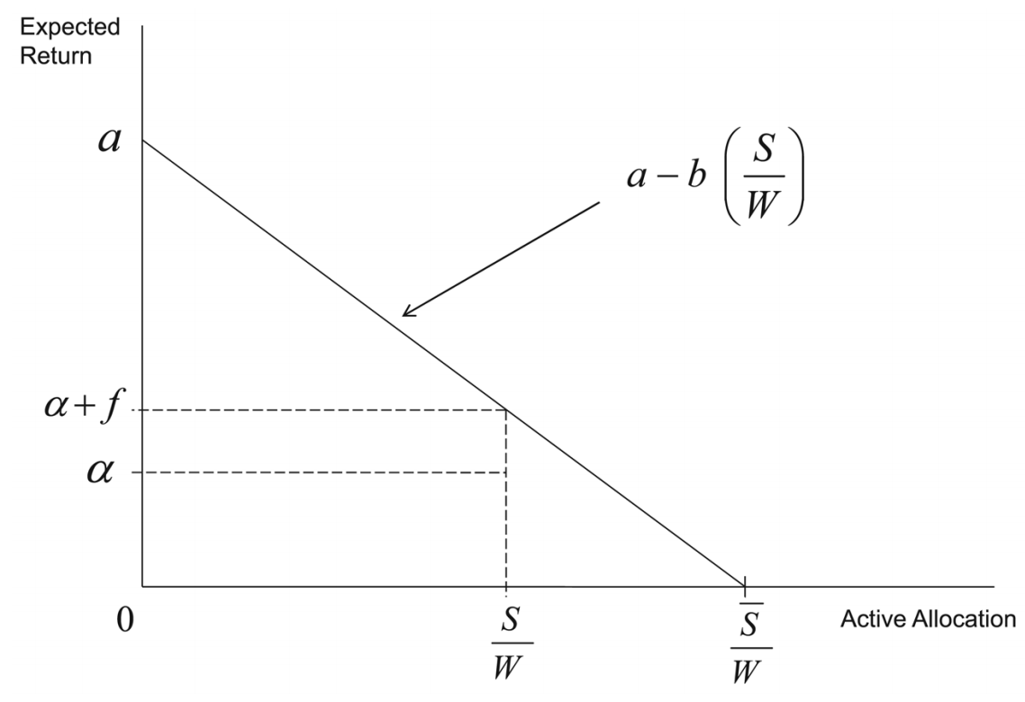
Setting
The relation for the ith element of alpha:
$α_{i}=a−b{\left(\frac{S}{W}\right)−f}_{i};$ $f_{i}:fee revenue$
Plot: The relation between $α_{i}$ and the
amount of active investment
Notes:
This figure plots the theoretical relation between the expected benchmark-adjusted excess fund return before fees against the relative size of the active management industry.

Slide 15
Setting
For each investor j the allocations to the funds solve the problem
$max⁡\{\frac{E\left(r_{j} | D\right)}{\sqrt{Var\left(r_{j} | D\right)}}\}$
where the excess return on the investor’s portfolio is given by
$r_{j}=δ_{j}^{′}r_{F}+\left(1−δ_{j}^{′}ι_{M}\right)r_{P};$ $ι_{M}$ denotes an M-vector of ones

Slide 16
Equilibrium under Risk Neutrality
Proposition 1:
Perfect competition among both managers and investors ($M→∞$, N$→∞$), S/W=$\frac{\tilde{a}}{\tilde{b}}$
Perfect competition among managers but only a single investor ($M→∞$, N$=1),$ S/W=$\frac{\tilde{a}}{2\tilde{b}}$
Perfect competition among investors but only a single manager ($M=1$, N$→∞$), S/W=$\frac{\tilde{a}}{2\tilde{b}}$
Notes:
Then they made a more transparent analysis of the effects of competition that arise in the mean-variance setting with several propositions. Those proposition give the equilibrium values of the key quantities under three alternative specifications of the nature of competition between managers and investors.
Competition makes it easier to understand why the active management industry is large. When both managers and investors compete, the resulting industry size of S/W = a˜/b˜ i is twice as large as the profit maximizing size

Slide 17
Equilibrium in the Mean-Variance Setting
Proposition 2: mean-variance setting in which investors maximize the objective function in slides 13
In equilibrium with perfect competition among both managers and investors
If $\tilde{a}>0,\text{then} \text{S}\text{/}\text{W} \text{is} \text{given} \text{by} \text{the}\text{ (}\text{unique}\text{) }\text{real} \text{positive} \text{solution} \text{to} \text{the} \text{equation}$
If $\tilde{a}<0,$then S/W=0
Notes:
The paper also discussed the industry’s expected alpha. It states that In order for a positive allocation to active management to offer investors a higher Sharpe ratio than the passive benchmark, investors must expect compensation for the nondiversifiable risky component x as well as for uncertainty about alpha

Slide 18
Prior and Posterior Beliefs
Part III
Notes:
In this section, they discussed the prior and posterior beliefs about the key parameters, a and b, as well as beliefs about the alpha implied by those parameters. they also describe about their data selection

Slide 19
Prior Beliefs
To capture decreasing returns to scale, they specify a bivariate normal joint prior distribution for a and b, truncated to require that b ≥ 0:
$\left[\begin{matrix}a \\ b\end{matrix}\right]\sim N\left(E_{0},V_{0}\right)I \left(b≥0\right), where N\left(E_{0},V_{0}\right)$ denotes a bivariate normal distribution with mean $E_{0}$ and covariance matrix $V_{0}$. I(c) is an indicator function that equals one if condition c is true and zero otherwise.
$E_{0}=\left[\begin{matrix}E_{0}^{a} \\ E_{0}^{b}\end{matrix}\right], V_{0}=\left[\begin{matrix}V_{0}^{aa} & V_{0}^{ab} \\ V_{0}^{ab} & V_{0}^{bb}\end{matrix}\right]$, In this section, we focus on b_0= 0.1, a value of particular interest in the subsequent analysis.
Given the properties of the truncated normal distribution, this prior mean implies $V_{0}^{bb}$=0.016, and a prior standard deviation for b equal to $δ_{b}^{0}=0.076$

Slide 20
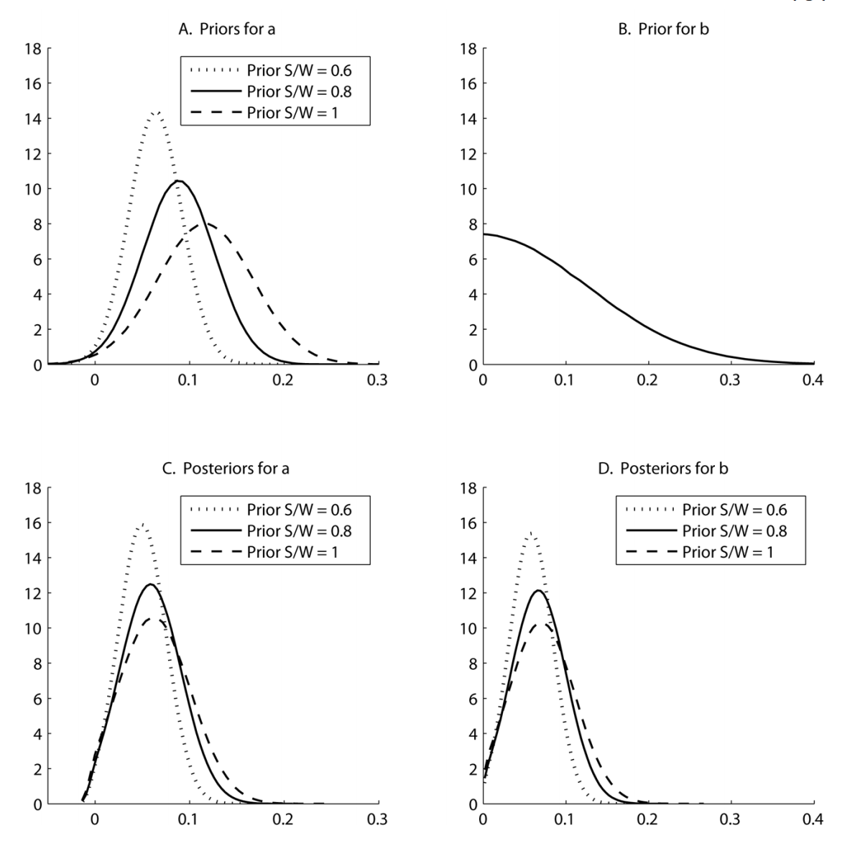
Figure One
Notes:
The figure plots priors and posteriors for a and b in the function a_t = a-b(S/W)-f ,
Panel A plots three different marginal prior distributions for a. All three distributions are normal.
The prior for b shown in panel B has a mean of 0.1. Three priors for a based on that value are shown in panel A. All three have the property prob(a < 0)= 0.01 but differ with respect to the “prior S/W ”: the S/W under the fully competitive equilibrium based only on prior beliefs. Panels C and D display the posteriors obtained after updating with the mutual fund data, covering the 1962–2005 period.
Panels C and D show the posterior distributions for a and b. Compared to the priors, the posteriors are shifted to the left, indicating a downward revision in beliefs about a and b.

Slide 21
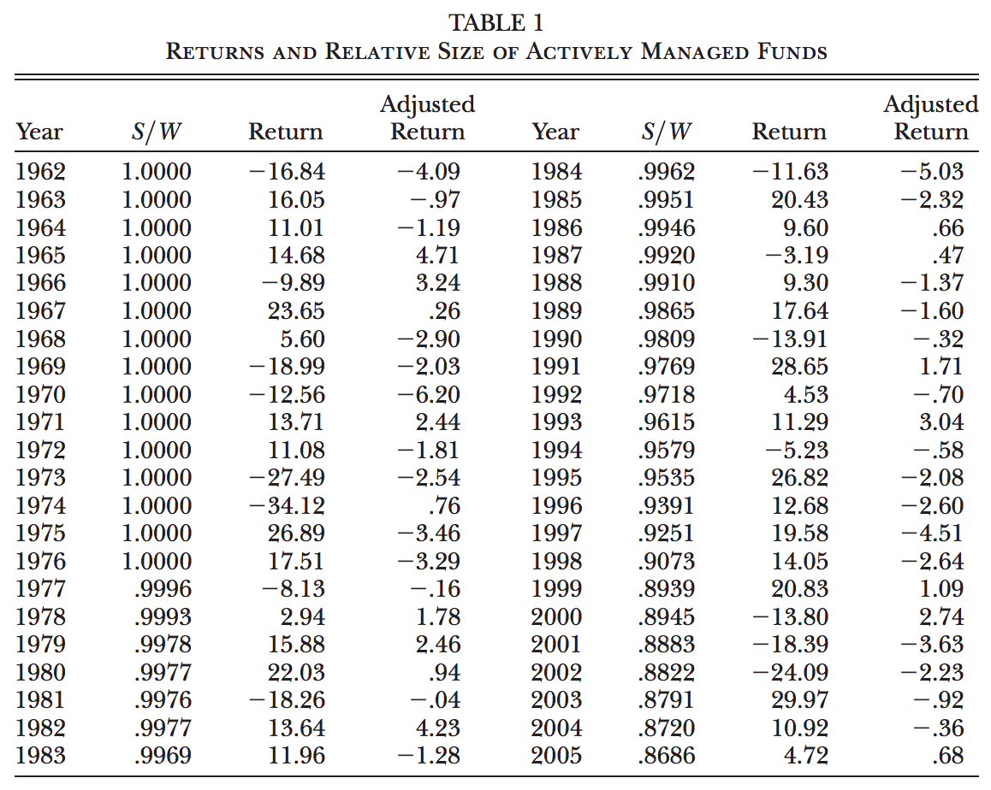
Figure Two
Notes:
The table reports the fraction of total US mutual fund assets that are actively managed, the percentage return on that aggregate active portfolio, and the portfolio’s market-adjusted return. The adjusted return is equal to the intercept plus the residual in a regression of the active portfolio’s return on the market return. The value of S/W is for the end of the year during which the corresponding return occurs.

Slide 22
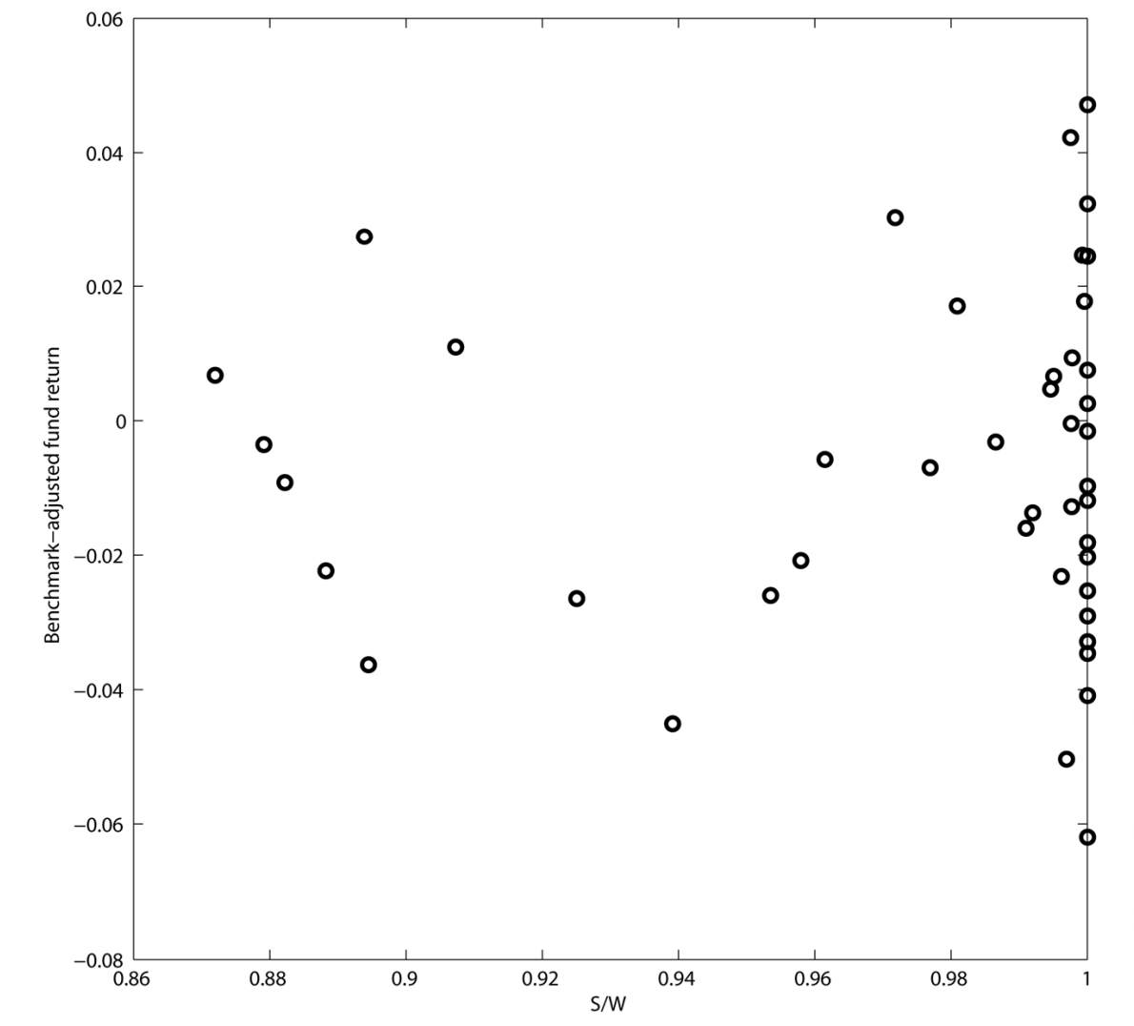
Figure Three
Notes:
The figure plots the annual observations of the fraction of total US mutual fund assets that are actively managed (horizontal axis) versus the market-adjusted percentage return on that aggregate active portfolio (vertical axis). The sample period is 1962–2005, and each S/W value is for the beginning of the year during which the corresponding return occurs.
It is immediately clear from figure 3 that these estimates are very imprecise because more than half the observations are bunched on top of each other at the right-hand-side edge of the plot

Slide 23
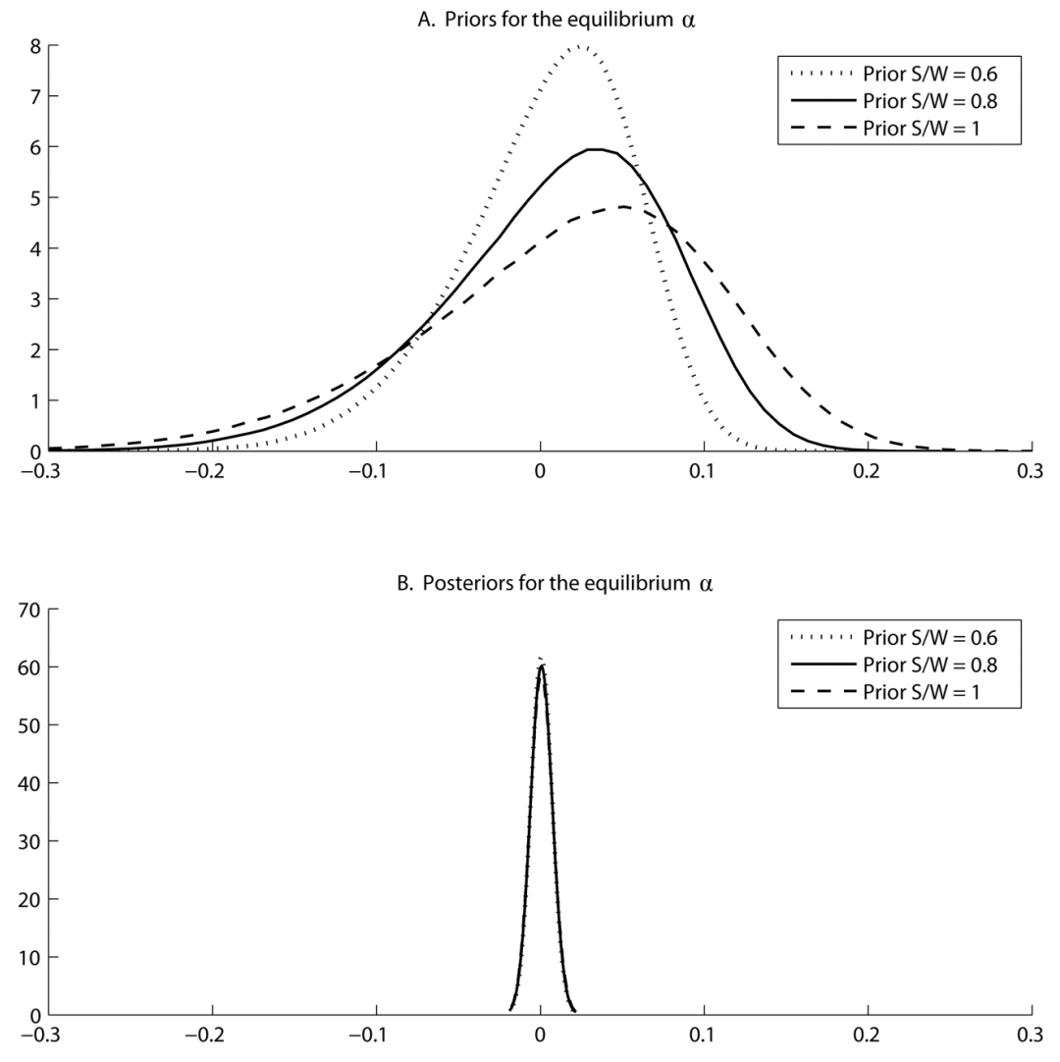
Figure Four
Notes:
Figure 4 shows that all three priors are rather noninformative about alpha, in that most of the probability mass is on values between roughly -20 percent and 20 percent per year. The prior standard deviations range from 5.3 percent to 9.1 percent per year across the three priors. In contrast, the posteriors for alpha are much tighter: all three posterior standard deviations are just below 0.5 percent per year. The large difference between panels A and B indicates that the 44-year sample contains a lot of information about the equilibrium alpha

Slide 24
Is the Industry’s Size Puzzling Given Its Track Record?
Part IV
Notes:
In this section, they use the model to ask whether it is puzzling that the active management industry remains large, given its unflattering historical performance. Specifically, they explore properties of prior beliefs that would lead the rational investors in the model to choose a large allocation to active management, once they update their beliefs with the historical data, Their model is not limited to mutual funds, but their empirical analysis treats that segment as representative of active management’s relative size and track record, given the availability of mutual fund data. They take the most recent value of the S/W series described earlier, 0.87, as the empirical benchmark against which to compare equilibrium values of S/W implied by the model.

Slide 25
Importance of Decreasing Returns to Scale
Figure Five
Notes:
For different numbers of funds (M) and investors (N), the figure plots the equilibrium aggregate allocation to active management (S/W ) based on updated beliefs that incorporate mutual fund data for the 1962–2005 period. For each value of the prior mean of b, the prior for a is specified such that prob(a < 0)= 0.01 and the equilibrium S/W equals 0.8 in the perfectly competitive case (M → infinity, N → infinity) when based only on the prior distribution for a and b. The “Data” line represents S/W =0.87, the value at the end of 2005 for the mutual fund industry.
We also see that S/W in figure 5 takes substantially lower values as the prior mean of b moves closer to zero.

Slide 26
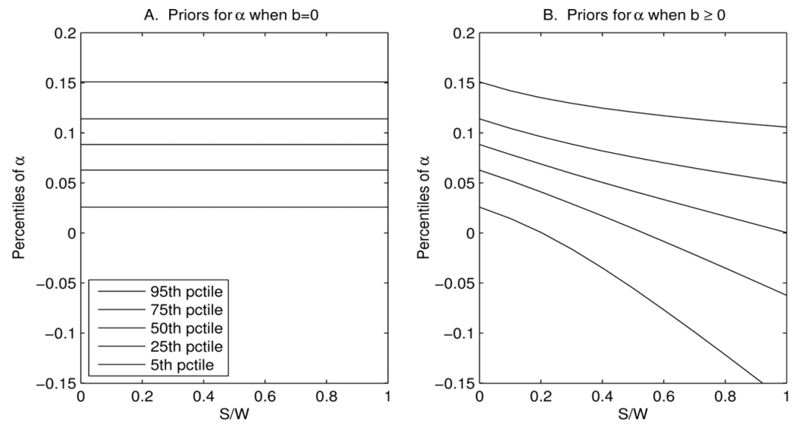
Decreasing Returns versus Optimism
Figure Six
Notes:
Panel A of figure 6 displays percentiles of the prior for a in the b=0 specification described above. This prior is the same as the distribution for a displayed as the solid line in panel A of figure 2. With b =0, this is the prior for a at all levels of S/W .

Slide 27
Robustness
Figure Seven
Notes:
Figure 7 displays the equilibrium S/W in the fully competitive setting after updating these alternative priors with the historical data. Each panel reports results under all three prior values of S/W . Panel B maintains the original specification of prob( a < 0 )=0.01; in panel A that probability is 10 times smaller, while in panel C it is 10 times larger.
Result:, as b_0 increases, the equilibrium level of S/W rises sharply to a level approximately equal to the empirical benchmark. It does not rise quite that high in panel C, which assigns a nontrivial 10 percent probability to even the first dollar of active management being unprofitable, but in general the results are robust to the various alternative specifications of the prior for a.

Slide 28
Future Size of the Active Management Industry
Part V
Notes:
In this section, they conduct simulations to calculate the expected future industry size after observing various potential track records, and they use the same simulations to investigate the speed of learning about returns to scale.
They find that the industry is likely to remain large even if it continues to underperform, and that learning about a and b is slow, highlighting the rationale for treating these quantities as uncertain.

Slide 29
Expected Future Industry Size
They assess the expected future size of the active management industry conditional on a summary measure of the industry’s future track record, and assume that investors enter the future with beliefs about a and b consistent with the industry’s current size. They then compute the expected future values of the equilibrium S/W for different values of the t-statistic of the industry’s future estimated alpha.
They find that S/W is likely to remain large for a long period of time, even if the industry’s future alpha turns out to be significantly negative as measured by the t-statistic.

Slide 30
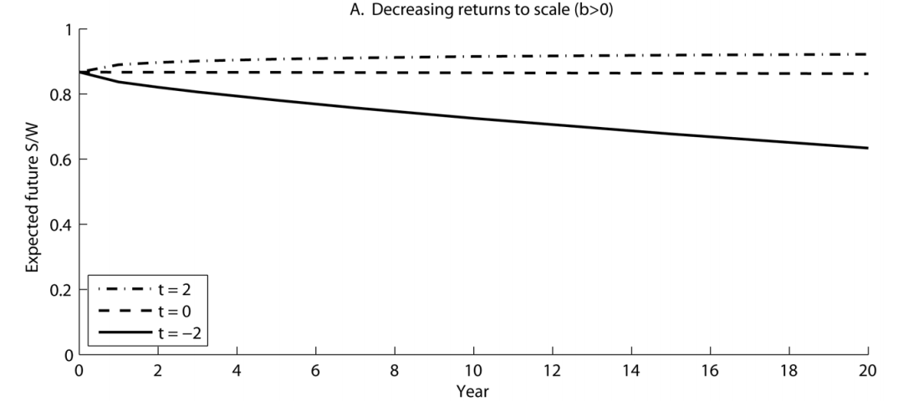
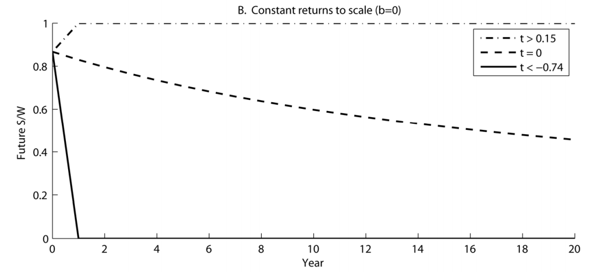
Figure Eight
Notes:
Panel A shows the industry is expected to remain large even if it continues to significantly underperform its benchmark. This striking result is due to decreasing returns to scale. Investors observing underperformance reduce their active allocation, but not as much as they would under constant returns to scale because they understand that when they allocate less to active management, their future active returns will be higher
Panel A also shows If the industry performs better than expected, it grows at the expense of passive investments, but its growth is restrained by decreasing returns to scale: investors know that when they allocate more to active management, their future returns will be lower. Because of this key mechanism, S/W is expected to vary slowly over time regardless of performance. Overall, panel A of figure 8 shows that the active management industry is likely to remain large for many years.
Panel B of figure 8 shows that under constant returns to scale, the industry’s size is much more sensitive to performance

Slide 31
Conclusion
Part VII

Slide 32
Conclusion I
Authors propose a potential resolution to the puzzle of active management remains popular despite its poor track record.
They use a model with competing investors and fund managers, and find that the large observed size of the active management industry can be rationalized if investors believe that active managers face decreasing returns to scale
If investors instead believed that returns to scale were constant, they would allocate nothing to active management today, even if they were initially more optimistic about active managers’ abilities.

Slide 33
Conclusion II
Under decreasing returns to scale, investors adjust their allocation in response to performance to achieve the desired expected return going forward. After a period of underperformance, the proportional allocation to active management should be smaller than it was at the beginning of the period, but it should also remain substantial. Both predictions are consistent with the empirical evidence for active mutual funds, which have underperformed passive benchmarks over the past four decades
They also show that the active management industry is likely to remain large for many more years, even if it continues to perform poorly
Investors in their model face endogeneity that limits their learning. Owing to this endogeneity, the equilibrium allocation tends to vary little over time, resulting in slow learning about the degree of returns to scale in active management. Initial beliefs about returns to scale thus affect the investors’ active allocations for a long time.

Slide 34
Further Research Suggestion
Besides estimating returns to scale at the aggregate level, people could try to measure them for various segments of the active management industry
People can also explore additional aspects of learning about the parameters governing returns to scale. Those parameters are held constant in their model for simplicity, but they could plausibly vary because of exogenous shocks, such as shocks to market liquidity

Slide 35
My Opinion
They developed their model from Berk and Green, and through all contents I mentioned above, they provide a potential solution to the puzzle that active management remains popular despite its poor track record.
Although there are still some other directions of looking at that puzzle, I think their solution is convincible.

