Slide 1
Mixing Washington Consensus with Beijing Consensus and Corruption in Africa
By OMER GOKCEKUS and YUI SUZUKI
Li, Dong
Master of science in Quantitative Finance
Olin Business School
部门：设计部

Slide 2
CONTENTS
PART 01
PART 02
PART 03
PART 04
Paper Preamble
Arguments & Model
Regression Results
Conclusion & Further Thoughts

Slide 3
PART 01
Paper Preamble
China has been increasing its presence as African countries' top trading partners
The OECD presence has been partially substituted
Is China’s growing presence a cause of increasing African corruption?

Slide 4
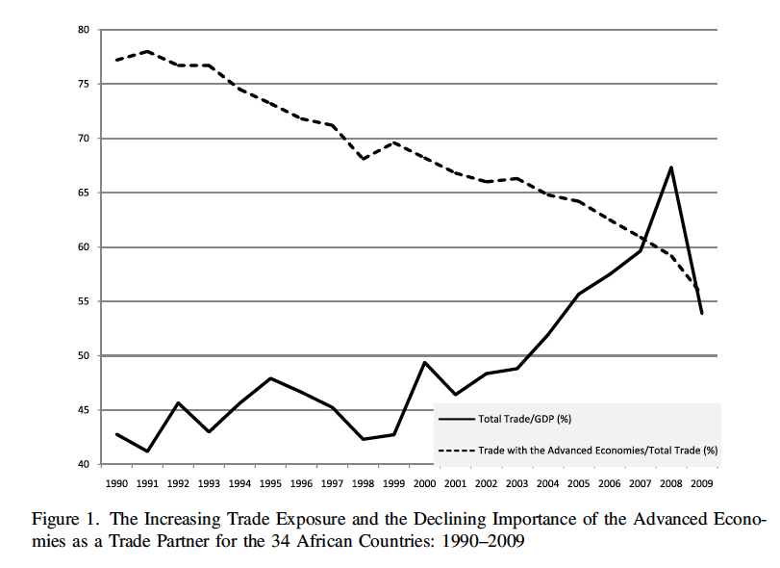
Diminishing OECD Effect
For the 34 Selected African Countries
For the period 1990-2009, trade gradually made up larger portion of the total GDP
However, the proportion of OECD trade activities seem to cease
1992
2009
56%
37%
Trade with
OECD
VS.
14%
Trade with
China
2%
VS.
ICRG Corruption Score
2.85
VS.
1.95

Slide 5
Diminishing OECD Effect
The Relationship
Normally, the intensity of corruption should decrease with increasing economics openness.
In practice, the intensity of corruption in African countries does not decrease with increasing openness
Washington Consensus
good governance and “conditionality” strategy
Advocate human right record, freedom of speech, etc.
Reform projects
Beijing Consensus:
Chinese mode of operation
Opposed to liberal agendas and conditionality
Erode the power of Advanced Economics

Slide 6
Trade intensity VS. Corruption
Channel1
More Complicated Trade Law
Liberal Trade Regime
Less open market often associates with a more complicated trade law.
More open market often associates with a less complicated trade law.
01
01
Rents / Law Interpretation
Simplified Trade Law
VS.
Leaves less room for subjective law interpretation..
Complicated trade law leads to higher rent, and more subjective interpretation of laws.
02
02
Bribe/Power Abuse
Less Corruption
Create an environment that is more susceptible to corruption.
The benefit of bribe and corruption diminishes.
03
03

Slide 7
Trade intensity VS. Corruption (Cont.)
Channel 2
Foreign Competition
01
Increasing presence of foreign technology increases competition.
Allocation of Resources
02
Capital tends to follow to firms with efficient production and competitive advantage.
Diminishing Corruption
03
Companies are refrained from low productivity and decrease benefits of corruption.

Slide 8
PART 02
Arguments & Model
Relevant Factors
Data
Model Forms

Slide 9
Relevant Factors
Per Capita Income
Proxy of level of economic development
Priori expectation: Negative relationship between corruption and economic development
Diversity
Ethnic Diversity as variable
Priori expectation: Positive relationship between corruption and ethnic diversity
Democracy Score
Democracy Accountability as variable
Democratic country requires smaller public sector rents

Slide 10
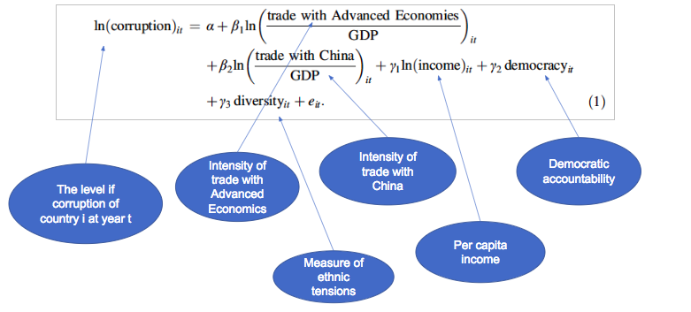
Model Form

Slide 11
Model Form
Initial Intensity of Trade Factor = Volume of trade with Advanced Economics(China)/ GDP
However, As Knack and Azfar (2003) show, there is a possible relationship between size of the country and its openness. If size of country is correlated with corruption, the estimated coefficient is biased.
Therefore, the author decides to use total trade volume instead of GDP, to remove the size effect.
▼
Equation 2

Slide 12
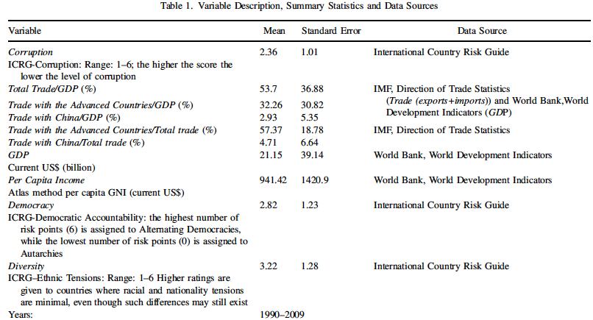
Data Summary
Panel Data
34 African Countries
20 Years
For corruption, democracy and diversity, higher ratings imply lower corruption, more democratic accountability and less ethnic tension
Accordingly, we expect the following signs for coefficients in equation 1 and 2:
$β_{1}$>0; $β_{2}$<=0; $γ_{1}$>0; $γ_{2}$>0; $γ_{3}$>0;

Slide 13
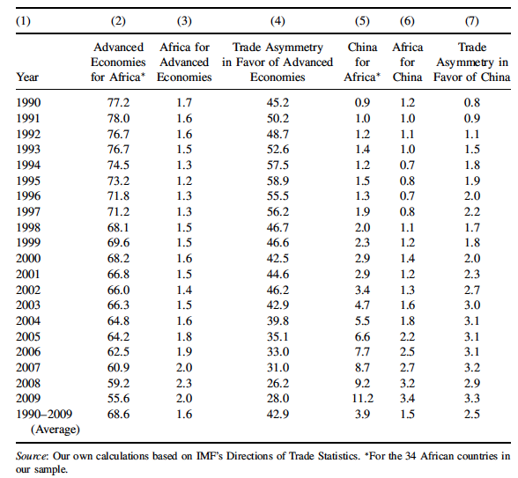
The Extent of The Asymmetry
Each other markets as % of Their Total Trade
Asymmetry in favor of the Advanced Economics
01
02
Trade with Advanced Economics/total trade of 34 African countries ① ;
Trade with 34 African countries/total trade of Advanced Economics ②;
Trade asymmetry in favor of the Advanced Economics= ①/ ②;
03
There is a significant asymmetry in favor of Advanced Economics, although the trend is decline

Slide 14
Regressors Construction
OLS
Classic OLS model
Fixed Effect Model
FE assumes that something within the individual may impact or bias the predictor, so it removes the effect of time-invariant characteristics
Random Effect Model
Fixed Effect Model
Random Effect Model
OLS
RE assumes variation across entities is assumed to be random and uncorrelated with the predictor

Slide 15
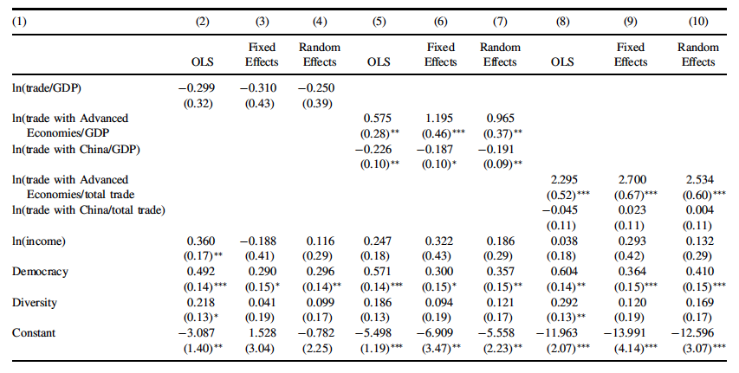
Result Interpretation
While higher democratic accountability has significant effect at 5% level on corruption, income and diversity do not have significant effect.
01
02
In RE in column(7), estimated coefficient for ln(trade with Advanced Economics/GDP) is 0.965 and significant at 5% level; estimated coefficient for ln(trade with China/GDP) is -0.191 and significant at 5% level
03
In RE in column (10), estimated coefficient for ln(trade with Advanced Economics/total trade) is 2.534 and significant at 1% level; estimated coefficient for ln(trade with China/ total trade) is 0.004, but it is not statistically significant.

Slide 16
PART 03
Conclusion & Further Thoughts

Slide 17
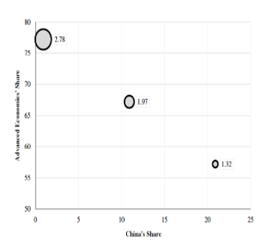
Conclusion
01
02
OECD & China
Democracy
An increase of trade with the Advanced Economies lowers the corruption; the intensity of trade with China either worsens corruption or has no effect on the level of corruption.
In these 34 countries, the level of corruption is also a function of democratic accountability.

Slide 18
Further Thought 1
China and OECD accounted for 78.1% of total trade in 1990
Is China the Sole Cause?
China and OECD accounted for 66.8% of total trade in 2009
From 1990 to 2009, total trade percentages combined by China and OECD decreases from 78.1% to 66.8%, by 11.3% .
The question becomes: Which country (or country group) substitute the loss of trade shares combined by China and OECD?

Slide 19
Further Thought 2
China Belt and Road Initiative
As of 2007, it is estimated that the Belt and Road Initiative project would pace itself to cover more than 68 countries, including 65% of the world population and 40% of the global GDP .
However, responses are not all positive. As one article from WSJ mentioned, “The capacity of Pakistan to repay the debt is extremely low and the Belt and Road program is essentially ‘loan-to-own’”
Interestingly, US is also reviving an agency named “Overseas Private Investment Corp” to counter Chinese growing influence. (WSJ)
Where else could this methodology could be applied?
Target countries have to make decisions about which source of capital to receive. And we can apply the same methodology to study the effect of Chinese and American investments on corruption, economic growth etc.

Slide 20
Thanks For Listening!

