Slide 1
Review “Giving Content to Investor Sentiment: The Role of Media in the Stock Market” ---Paul C. Tetlock
Literature Review and Critical Reasoning
Yichuan (Jackie) Yan - MSFQ 2018
September 2018

Slide 2
Executive Summary
Background
Paper:
Introduction & summary (w comments)
Previous theories (w comments)
Methods & reasoning (w comments)
(Additional) findings & conclusions (w comments)
Next steps
Questions

Slide 3
Irrelevance
Professor Paul C. Tetlock
https://www0.gsb.columbia.edu/faculty/ptetlock/research.html
Sentiment & media
Power of the words
Market efficiency
Systematic or discretionary (how should you value it)

Slide 4
Introduction
C1: High media pessimism robustly predicts downward pressure on market prices followed by a reversion to fundamentals.
C2: Unusual high or low pessimism predicts high market trading volume.
C3: C1 and C2 are consistent with theoretical models of noise and liquidity traders, and are inconsistent with theories of media content as a proxy for new information about fundamental asset values, as a proxy for market volatility, or as a sideshow with no relationship to asset markets.
market volume
volatility
media pessimism
media pessimism
market returns
Asset fundamentals

Slide 5
Introduction (cont.)
U.S. Stock market’s returns
Wall Street Journal’s (WSJ’s) “Abreast of the Market”
U.S. Stock market’s volumes
U.S. Stock market’s volatilities

Slide 6
Introduction (cont.)
General Inquirer (GI) is used to analyze daily variation in the column for 16 years; PCA is used to construct a measure of media pessimism as “pessimism factor.”
Wall Street Journal’s (WSJ’s) “Abreast of the Market”
Vector autoregressions (VARs) are used to estimate the intertemporal links between this measure of media pessimism and the stock market’s returns, volumes, volatilities, etc.

Slide 7
Comments
Chicken first or egg first?
Do people tend to post negative views more often than positive or no view? Or, do people use more intense words for negative views than the others? Classify people who have views?
Why PCA?

Slide 8
Previous Theories on the Effects of Sentiment on Stock Market
DeLong et al. (1990a)
Low sentiment will generate downward price pressure and unusually high or low values of sentiment will generate high volume
Campbell, Grossman, and Wang (1993)
Changes in the level of risk aversion for a large subset of investors can affect short-term returns. To distinguish noise and liquidity trader theories is to interpret the media pessimism variable for either sentiment of risk aversion
Unknown source
Media pessimism should have no effect on future market activity. WSJ’s “Abreast of the Market” is made to entertain readers. No information conveyed.
Unknown source
The media pessimism measure is a proxy for negative information about the fundamental values of equities that is not currently incorporated into prices.

Slide 9
Previous Theories (cont.)
Noise traders: hold random beliefs about future dividends
Two types of traders exist:
Define Pessimism
Rational arbitrageurs: hold Bayesian beliefs
Two key assumptions
Both types of traders are risk-averse and capital constrained
An equilibrium: noise traders’ random beliefs about future dividends influence prices. More specifically, noise traders sell stocks to arbitrageurs, increase the volume, and temporarily depress the returns; in the next period, when a new belief comes in, returns rebound.

Slide 10
Previous Theories (cont.): what this paper is about
This paper tests the specific hypothesis that high media pessimism is associated with low investor sentiment, resulting in downward pressure on prices.
It is unclear whether media pessimism forecasts investor sentiment or reflects past investor sentiment.

Slide 11
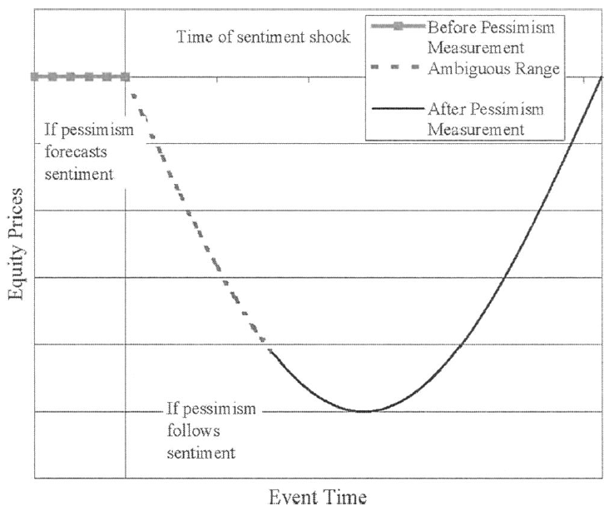
Previous Theories (cont.): the most likely scenario

Slide 12
Comments
Information theory and sentiment theory?
Why (only) choose WSJ? 325,000 professionals; accessible electronic version.

Slide 13
Methods and Reasonings: generating the pessimism media factor
General Inquirer (GI) counts the number of words in each day’s column that fall within various word categories, defined by Harvard IV-4 psychosocial dictionary.
To minimize semantic and stylistic noise in the column, all GI categories is re-centered so that their conditional means are equal across different days of the week. Day-of-the-week dummy variables are used.
PCA is used to extract the most important semantic component from the (77 x 77) variance-covariance matrix of the categories in the Harvard dictionary and makes the component a “pessimistic factor.” Negative, Weak, Fail, Fall.
PCA: https://stats.stackexchange.com/questions/2691/making-sense-of-principal-component-analysis-eigenvectors-eigenvalues

Slide 14
Methods and Reasonings: generating the pessimism media factor
Is time variation in the GI categories stable?

Slide 15
Comments?
Alternative approaches to select the categories? Tree-based methods? Lasso/Ridge?
Could such strong correlation continue or subject to a regime shift?

Slide 16
Methods and Reasonings: market activity and pessimism
Vector autoregressive (VAR)
Returns, volume, pessimism factor
Robustness and sensitivity
Still valid given a change?
Economic importance
Any profitable trading strategy?
This study controls for the influence of the lagged returns of indices and lagged returns of any larger indices. Regressions also include lagged volume to try to capture liquidity effects.

Slide 17
Methods and Reasonings: VAR estimates
Vlm: detrended daily volume on the NYSE
SMB: Fama and French daily small-minus-big factor
Dow: daily returns on the Dow Jones Industrial Average
BdNws: the pessimistic media factor
L5: [Xt-1 Xt-2 Xt-3 Xt-4] five lags
Exog: the exogenous variables include five lags of the detrended squared Dow residuals that proxy for past volatility, dummy variables for day-of-the-week and January that control return anomalies, and a dummy variable for Oct. 19th stock market crash

Slide 18
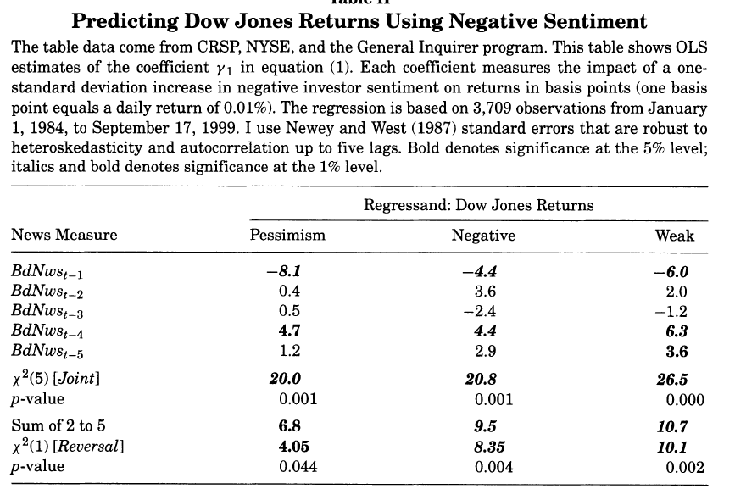
Methods and Reasonings: VAR estimates - returns

Slide 19
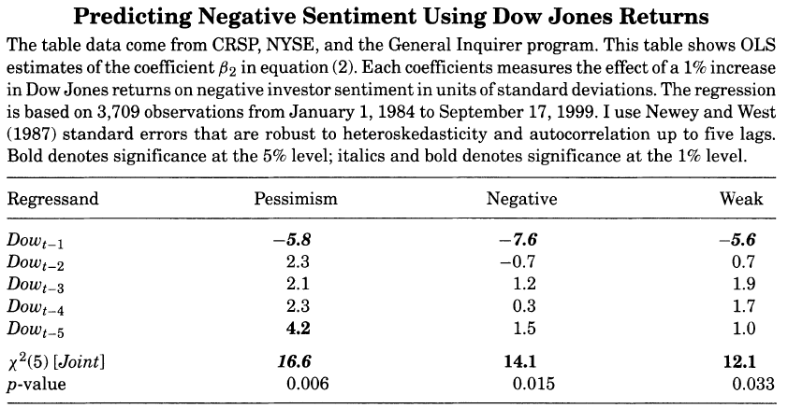
Methods and Reasonings: VAR estimates - sentiment

Slide 20
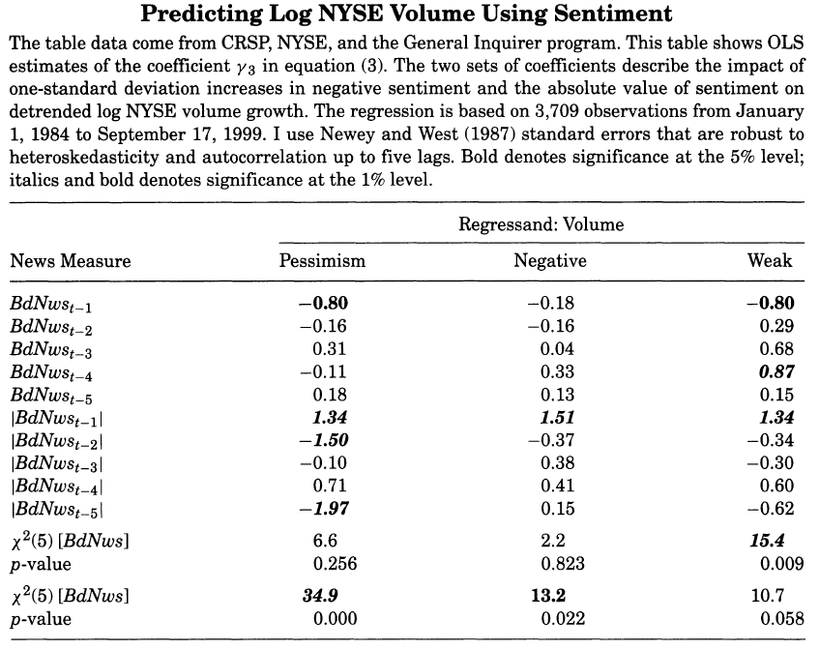
Methods and Reasonings: VAR estimates - volume

Slide 21
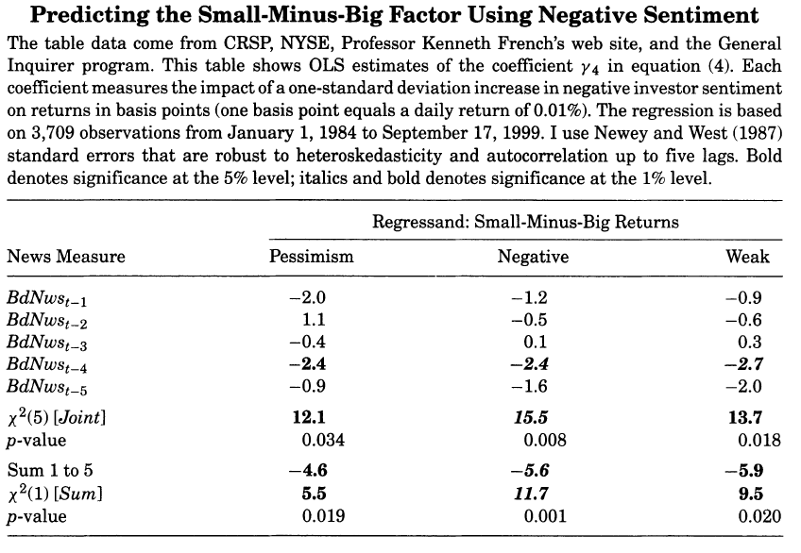
Methods and Reasonings: VAR estimates - SMB

Slide 22
Methods and Reasonings: VAR estimates - conclusions
The negative sentiment has a significant temporary impact on future Dow Jones returns that is fully reversed within one week.
A decrease in return causes an increase in negative sentiment.
Rejects the theories of media pessimism as a proxy for trading costs; agrees with the theories of pessimism as a proxy for sentiment (Camplbell et al. (1993) and DeLong et al. (1990a)).
Negative sentiment seems to have a longer-lasting and larger impact on small stocks. (comment)

Slide 23
Why to Test Robustness?
What if the afternoon WSJ contains late-breaking information not completely incorporated in closing prices, then investors continue to react to news on the next trading day?
Although theories of media content as a proxy for information about fundamental asset values could be consistent with some of the regression results we get, these theories do not allow the existence of noise and liquidity traders that do exist in reality.

Slide 24
Methods and Reasonings: robustness and sensitivity analysis
The question here is whether the pessimism factor is concentrated in after-hours and opening hours returns or is dispersed uniformly throughout the trading day.
Lag is applied: use a return window that begins on 10 a.m. the day after the column is released on the newswires; control variables are added to capture the influence of closing and opening returns and volume.

Slide 25
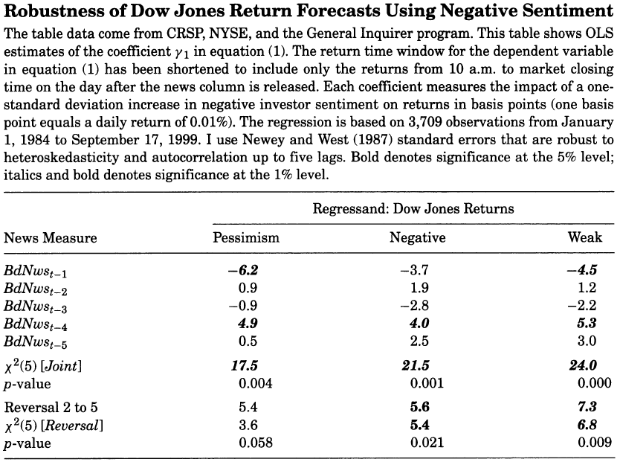
Methods and Reasonings: robustness and sensitivity analysis

Slide 26
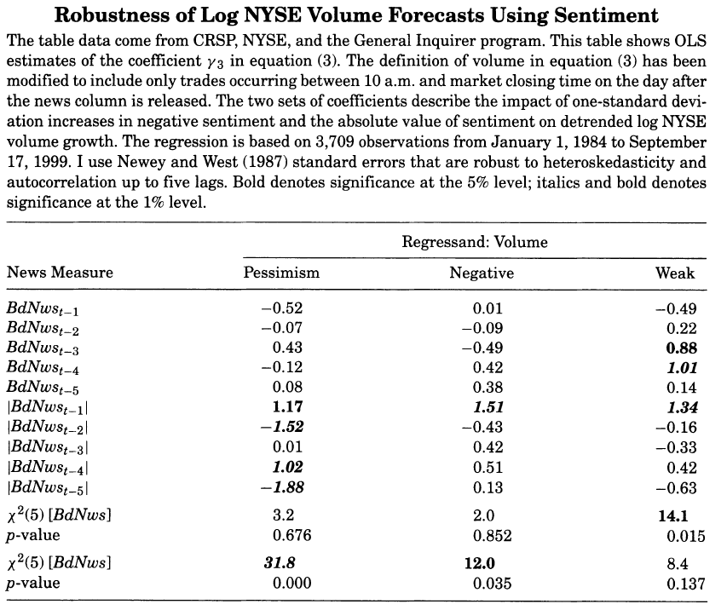
Methods and Reasonings: robustness and sensitivity analysis

Slide 27
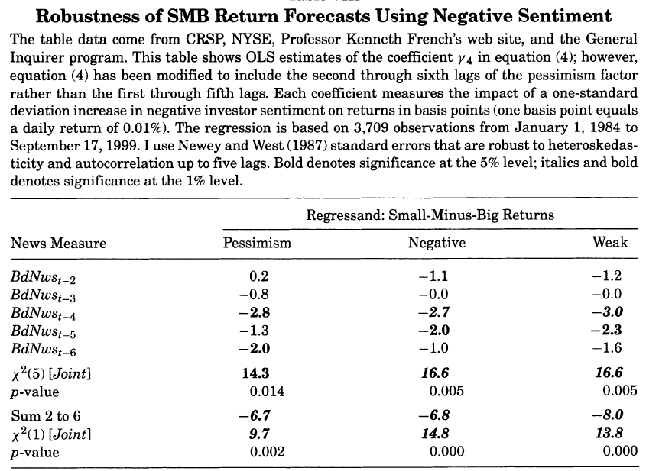
Methods and Reasonings: robustness and sensitivity analysis

Slide 28
Methods and Reasonings: robustness and sensitivity analysis
From the similarities between all the tables presented, it appears that the market response to pessimism is dispersed throughout the following trading week. It is likely that much of the immediate response to true information contained in the column has already occurred even before the column has been written. == “column is written before the end of the prior trading day.”
However, there is another hypothesis: market valuations during the bull market of the 1990s were affected by “irrationally exuberant” traders. The sentiment measures examined should exert a larger impact during the second half of the sample.
Depending on the size of the transaction, costs attributable to bid-ask spreads and finite market depth may exceed 4.4 basis points per trade – the cutoff value for eliminating the profitability of a pessimism-based trading strategy.

Slide 29
Methods and Reasonings: robustness and sensitivity analysis

Slide 30
Methods and Reasonings: robustness and sensitivity analysis
By far, everything is from parametric estimates. What if we use a semi-parametric estimate?
Omitting only the lags of the negative sentiment measures from the linear regression, to obtain an estimate of the unexplained residual daily Dow return
For a nonparametric estimate of the effect of negative sentiment on this residual Dow return with a standard locally weighted regression
Pessimism media factor, Negative words Category, and the Weak words category

Slide 31
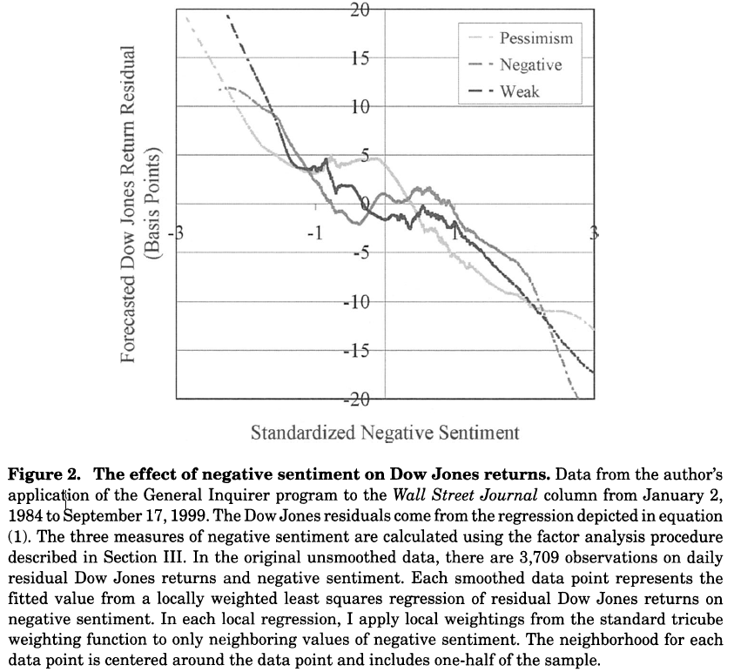

Slide 32
Methods and Reasonings: economic important of the results
IF Negative words are in the bottom third of the prior year’s Negative word distribution
IF Negative words are in the top third of the prior year’s Negative word distribution
Benchmark
THEN borrow at the riskless rate to purchase all the stocks in the Dow Jones Index and sell them back one day later
THEN borrow all the stocks in the Dow Jones index, receiving the risk-less rate, and buy them back one day later

Slide 33
Methods and Reasonings: economic important of the results
Buys the index 1,281 times and sells the index 1254 times in the 3,700+ trading days between 1985 and 1999
The average daily return of this zero-cost strategy is 4.4 basis point, which is slightly larger than the average daily excess return on the Dow Jones itself
The annualized return of the pessimism-based strategy is 7.3%
Depending on the size of the transaction, costs attributable to bid-ask spreads and finite market depth may exceed 4.4 basis points per trade – the cutoff value for eliminating the profitability of a pessimism-based trading strategy.

Slide 34
Whether pessimism factor relates to investor sentiment?

Slide 35
Conclusions
C1: High media pessimism robustly predicts downward pressure on market prices followed by a reversion to fundamentals.
C2: Unusual high or low pessimism predicts high market trading volume.
C3: C1 and C2 are consistent with theoretical models of noise and liquidity traders, and are inconsistent with theories of media content as a proxy for new information about fundamental asset values, as a proxy for market volatility, or as a sideshow with no relationship to asset markets.

Slide 36
Additional Findings
Price impact of pessimism appears especially large and slow to reverse itself in small stocks == sentiment theory (media content is linked to the behavior of individual investors)
The changes in market returns that follow pessimistic media content are dispersed throughout the trading day, rather than concentrated after the release of information.
The negative returns following negative sentiment are reversed over the next few days of market activity.
Pessimism strongly predicts market volatility.
A sentiment-based trading strategy guarantees high return.

Slide 37
Next Steps
Profit vanished?
S&P500 or Russell 2000?
Regime shift since 2007? Crash? Inputs? Returns?
Macro-level to micro-level?
Deep learning models?

Slide 38
Larger takeaways
Alpha is a zero-sum game
Competitive
Predictability battle
You want your action to be less predictable
Data
Trash in, trash out

Slide 39
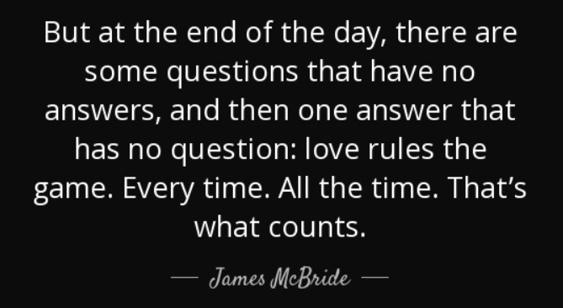
Questions?

Slide 40
Thank You

